Slide 1
Digital Image Processing

Slide 2
Table of content
Problem Statement and Expectations from the Project
Augmentations:
Amplitude Rescale
Phase Shift
Random Frequency Mask
Gaussian Mixture Mask
Model Architecture:
ResNet18
MobileNetV3
Training Strategy
Results

Slide 3
Problem Statement
The problem focuses on improving supervised learning performance by leveraging frequency domain information through Fourier-based data augmentations, inspired by the paper "Disentangling the Effects of Data Augmentation and Format Transform in Self-Supervised Learning of Image Representations". The goal is to enhance generalizability in model performance.
Image Classification: Given an image, apply Fourier domain augmentations to enrich the training dataset and evaluate the impact on model generalization across diverse test distributions.
Targets:
Input Image Size: 224x224 (standard for most classification benchmarks)
Metric: Accuracy
Minimum Classification Accuracy: ≥ 90% across Animal10 test set)

Slide 4
Solution :
Fourier domain augmentation for improved supervised learning

Slide 5
Fourier Domain in Images
The Fourier domain represents an image in terms of its frequency components rather than pixel intensities.
It is obtained by applying the Fourier Transform (typically 2D Discrete Fourier Transform or FFT) to an image.
Key Concepts:
Low Frequencies: Represent smooth regions and general shapes (e.g., background, illumination).
High Frequencies: Capture sharp edges, textures, and fine details.
Amplitude Spectrum: Shows the strength of each frequency.
Phase Spectrum: Encodes the spatial structure and position of features.

Slide 6
Why Use It?
Enables frequency-based filtering, augmentation, and compression.
Useful for tasks like denoising, texture analysis, data augmentation, and adversarial defense in machine learning.

Slide 7
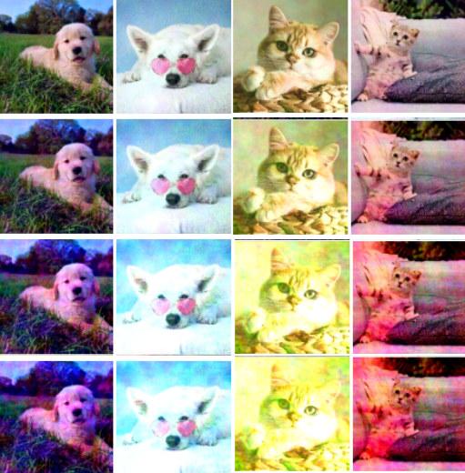
Amplitude Rescale

Slide 8
Generate a uniform noise vector p ∈ ℝH×W with range [m, n), where m, n > 0 (empirically chosen).
Apply noise to the amplitude spectrum: A(f) = A(f) ⊙ p
Noise is sampled per channel in the FFT of a 3-channel image.
Inverse FFT (F⁻¹) brings it back to image domain.
Effect: Introduces non-uniform perturbations to image color, enhancing diversity in training data.

Slide 9
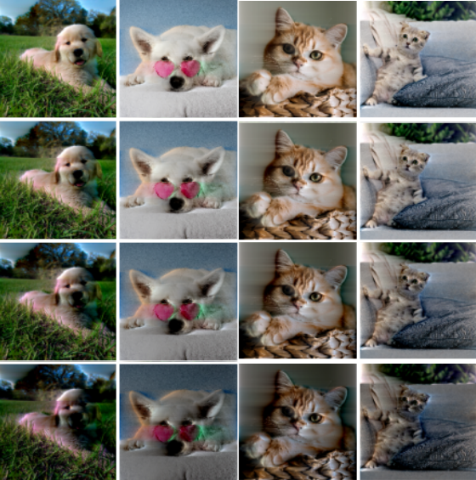
Phase Shift

Slide 10
Sample a constant shift factor θ ∈ ℝ from range [p, q), where p, q > 0 (empirically chosen).
Apply shift to the phase component of the spectrum: P(f) = P(f) ± θ
Phase shift affects frequency alignment during inverse FFT.
Effect: Creates a movement-like distortion, enhancing certain high-frequency details (e.g., brightness in edges/textures).

Slide 11
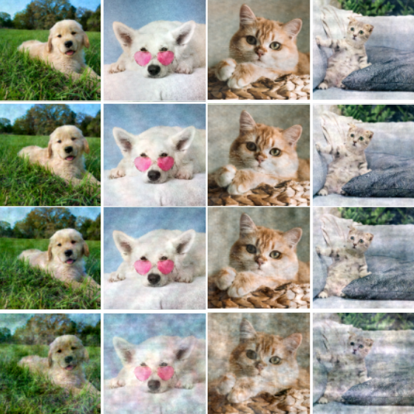
Random Frequency Mask

Slide 12
Create a binary mask h (shared across all channels) where k% of frequencies are set to 0.
Ensure zero frequency mode (h₀,₀) is always enabled to retain semantic structure.
Apply the mask: f = f ⊙ h
Effect: Randomly disables both high and low frequency components, creating a cloudy, nonuniform texture while preserving the image's color scope.

Slide 13
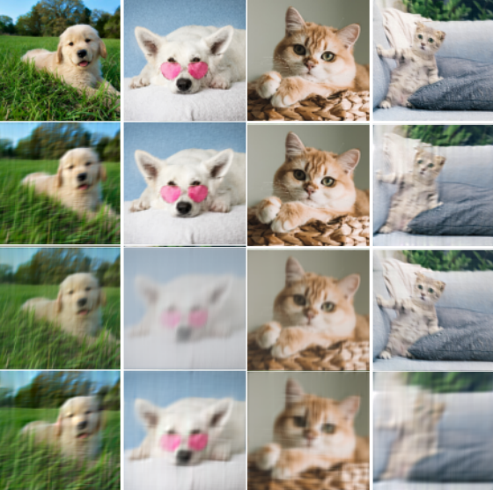
Gaussian Mixture Mask

Slide 14
Unlike traditional low-pass or high-pass filters (single centered circular kernels), we use a flexible frequency-band masking approach.
Construct a Gaussian Mixture Mask using:
Origins: c ∈ ℝo×2 (randomly sampled)
Standard deviations: σ ∈ ℝo×2
For each origin, compute a 2D Gaussian: G(u, v, c, σ) = exp[−((u−o₀)² / 2σ₀² + (v−o₁)² / 2σ₁²)]
Combine to create a flexible frequency mask that can suppress both low and high frequencies.
Effect: Produces textures with a mix of blurred and sharpened artifacts, maintaining semantic relevance.

Slide 15
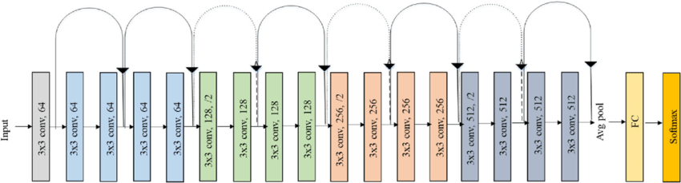
ResNet18
Input Layer Input size: 224 × 224 × 3 (RGB image)
Initial Convolution + Pooling
Conv1: 7×7, 64 filters, stride 2 → ReLU
MaxPool: 3×3, stride 2
Residual Blocks
Conv2_x: 2 × BasicBlocks
Each: 3×3 conv → ReLU → 3×3 conv + skip connection
Output: 64 channels
Conv3_x: 2 × BasicBlocks
Output: 128 channels

Slide 16
ResNet18
Residual Blocks
Conv4_x: 2 × BasicBlocks
Output: 256 channels
Conv5_x: 2 × BasicBlocks
Output: 512 channels
Global Average Pooling
Output size: 512 × 1 × 1
Fully Connected Layer

Slide 17
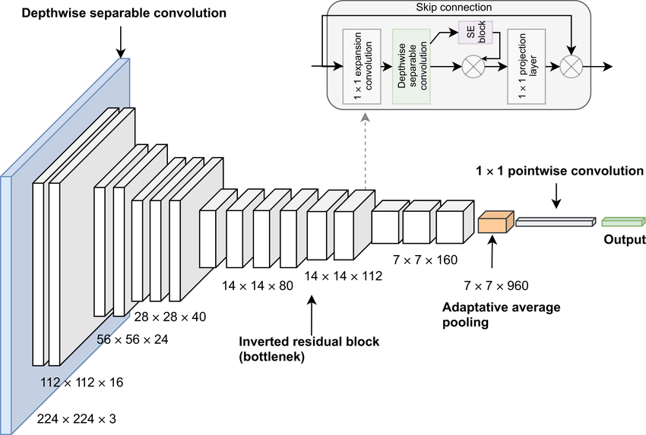
MobileNetV3
Input Layer
Input size: 224 × 224 × 3
Stem Block
3×3 Conv, stride 2, followed by BatchNorm + h-swish or ReLU
Bottleneck Blocks (Inverted Residual with SE) Each includes:
1×1 expansion conv (pointwise)
3×3 depthwise conv (spatial filtering)
Squeeze-and-Excitation (optional)

Slide 18
Bottleneck Blocks (Inverted Residual with SE)
1×1 projection conv
Non-linearity: ReLU or h-swish
Residual connection if input/output shapes match
Final Layers
1×1 Conv → BatchNorm → h-swish
Global Average Pooling
Fully Connected Layer (classifier)
Softmax
MobileNetV3

Slide 19
Training Strategy
Implement RFFT2D and IRFFT2D
Use PyTorch to perform forward and inverse Real-valued 2D Fast Fourier Transforms.
Device-Agnostic Augmentations
Implement all 4 Fourier domain augmentations so they work seamlessly on both CPU and GPU.
Random Augmentation During Training
In the __call__ function, randomly select one augmentation
Apply it to the input image before feeding it to the model
Disable Augmentations During Testing/Inference
Ensure clean input images are passed to the model for evaluation

Slide 20
Results
Model | Baseline | With Augmentation
ResNet-18 | 87.70% | 95.53%
MobileNetV3 | 87.85% | 94.10%

Slide 21
Conclusion
From the results, we conclude that Fourier Domain Augmentations outperform training without augmentations.
This demonstrates that such augmentations can significantly enhance generalizability in supervised learning settings as well.
These methods introduce frequency-level diversity without compromising semantic content, leading to better performance across models.

